Slide 1
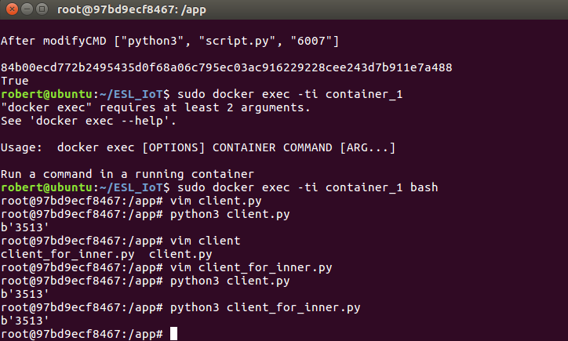
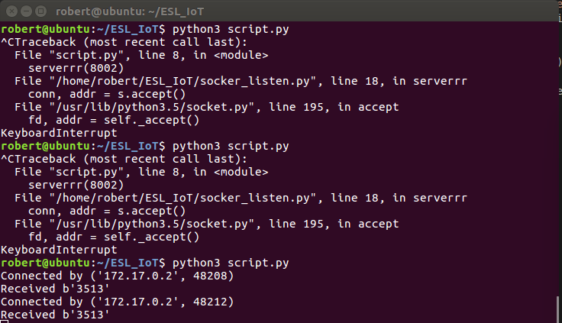
Container To HOST
Container_1
HOST

Slide 2
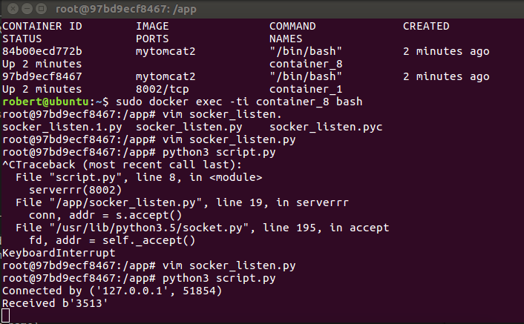
Container_1 To Container_2
Container_2
Container_1

Slide 3

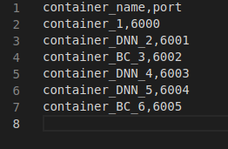
Add new command
1
2

